Slide 1
Driving results for governments and the citizens they serve.
Avenu partners with state and local officials to boost revenue, optimize operations, and deepen community trust.
Notes:
This “quick strike” presentation deck serves as an introductory template for talking about Avenu and what we can offer local governments.
Review its contents and customize this deck before each presentation to best suit the anticipated needs and questions of your audience.
If necessary, save a separate version of this deck for each presentation.

Slide 2
What we’ll cover today.
An Introduction to Avenu Insights & Analytics
The People, Governments, and Communities We Serve
Our Solutions: Services and Technology for the Future
How We’ve Helped Other Communities Grow
ACCOMPLISH MORE — WITH INSIGHTS & ANALYTICS
Notes:
The outline should be edited and tailored to the specific product/solution you are presenting at the time.

Slide 3
Last year, we found more than $1.3 billion in revenue for local governments.
Avenu Insights & Analytics discovers, recovers, and analyzes revenue for local governments.
We work closely with elected officials, finance and budget officials, and other government decision-makers to capitalize on unrealized revenue — spurring growth for their communities.
ACCOMPLISH MORE — WITH INSIGHTS & ANALYTICS
Notes:
This is a top-level overview of what Avenu does, and how it can benefit local governments.
Always introduce Avenu as a company with a successful track record increasing revenue by finding and recovering untapped sources. In other words, Avenu helps governments claim fund they are already entitled to, but may not even know are available. Instead of having to increase taxes or dig through mountains of paperwork to create revenue growth, governments can partner with Avenu to get results quickly and efficiently.

Slide 4

Avenu serves your entire community
More than 40 years serving state & local governments across the country
More than 3,000 state and local customers nationally
850 + employees across the U.S.
Based in Herndon, VA, Avenu maintains offices in California, Texas, New Jersey, Georgia, Alabama, Louisiana, Tennessee, Massachusetts, New York, Minnesota, Toronto, Halifax
Avenu is a leading provider of integrated revenue enhancement, managed services and administration solutions to local governments across the United States
Local governments are experiencing significant long-term fiscal and operational pressures driven by aging populations, ever-increasing demand for public services, pension liabilities and antiquated IT systems
Notes:
We’ve helped clients in a broad range of governmental roles streamline, modernize, and enhance their operations.

Slide 5
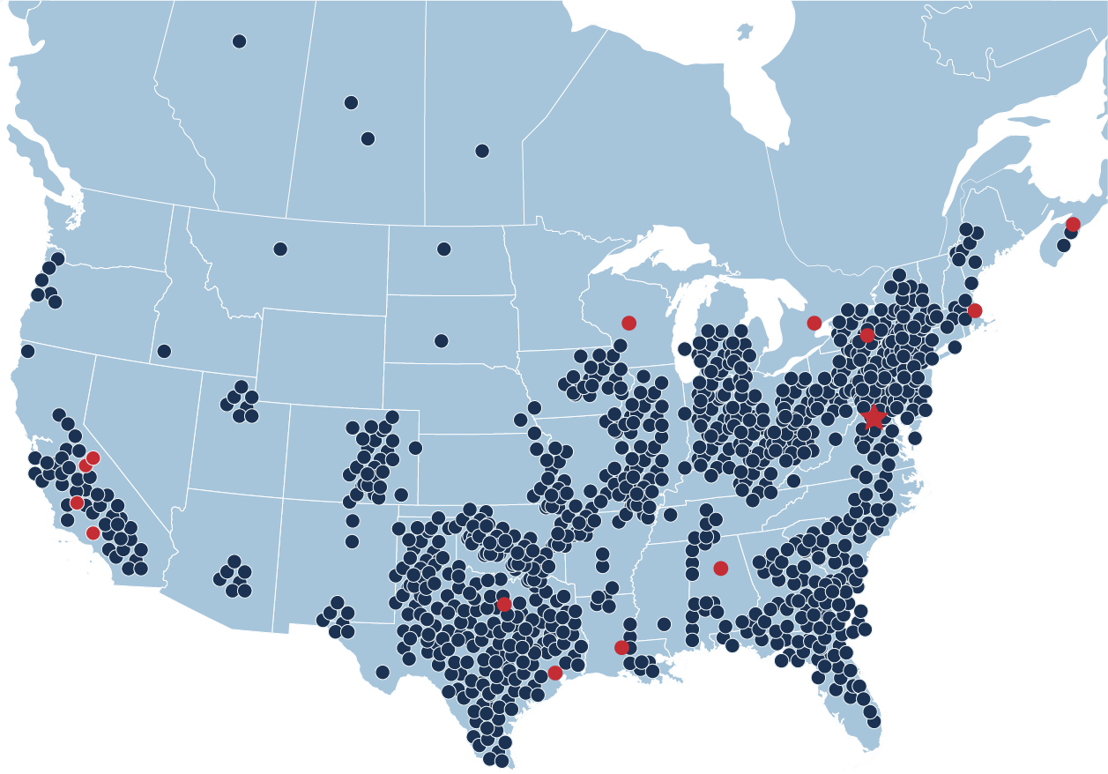
National
Footprint
50+
Presence in all 50 states and 5 Provinces
3,000+
State and Local Governments
Avenu Office Locations
Avenu Customer Locations

Slide 6
Our values mean we build solutions that strengthen our clients’ operations and foster community trust.
REVENUE ENHANCEMENT
ADMINISTRATION
We help elected and finance officials understand where their revenue is coming from and show them where they can take advantage of new and untapped revenue streams.
We support administrative officials with software that streamlines and supports mission-critical operations, making it easy to serve citizens reliably, efficiently, and securely.
Insight
Versatility
Commitment
Clarity
With greater process transparency and better digital experiences, citizens and businesses can engage with and trust their governments.
Notes:
Give your audience an overview of how Avenu serves a community holistically. This should paint the picture that we do more than serve the direct needs of the person/people you’re talking to.
Unmatched expertise in state and local government operations
Foundational excellence in compliance, administration, analytics, and outreach
Deep heritage of digital experience software solutions for government
An ever-expanding roster of clients across the United States — and beyond

Slide 7

Core Values
CLIENT-FOCUSED
CARING
RESPONSIVE
Our customers, partners, and employees are our priority. We provide meaningful expertise in a timely manner by actively listening and doing what we say we will do.
We genuinely care for those around us. We are respectful and lead by example. We share what we know and attempt to make those around us better than ourselves.
We act with a sense of urgency
for our customers, partners, and employees. We show up on time, always engaged and ready
to perform.
PASSIONATE
INTEGRITY
We conduct our work with passion and are energized by what we do. It inspires us to explore new ideas and technologies, and pushes us to work harder.
We do the right thing for our customers, partners and employees by upholding the values and principles of Avenu in every action and decision.

Slide 8

Avenu serves your entire community
We plan, project, and achieve revenue results for municipal and county elected officials.
We give budget and finance officials the data and support they need to find revenue and make administrative decisions for the future.
We help business taxpayers understand and comply with their compliance obligations.
INCREASED REVENUE =
STRONGER COMMUNITY
ACCOMPLISH MORE — WITH INSIGHTS & ANALYTICS
Notes:
Give your audience an overview of how Avenu serves a community holistically. This should paint the picture that we do more than serve the direct needs of the person/people you’re talking to; we solve revenue issues with partnership and support at every point of the discovery/recovery/remittance process.

Slide 9
More on what we can do for elected officials and government executives
Assess the existing state of revenue recognition and identify opportunities
Create a detailed roadmap for revenue recovery with clear milestones
Accurately project future untapped revenue
Discover and recover revenue on contingency — no up-front cost
Provide a compliant culture in your community — a “level playing field”
Support officials with data, analytics, and services — increasing efficiency and compliance
Give businesses an easy online payment portal to boost compliance and administration
ACCOMPLISH MORE — WITH INSIGHTS & ANALYTICS
Notes:
Use this slide when speaking primarily with politicians. Hide the following slide.
If you are not speaking with politicians, hide this slide.
Reorder these talking points as you see fit based on the priorities of your audience.

Slide 10
More on what we can do for finance executives
Assess the state of your revenue recognition and identify opportunities
Create a detailed plan for revenue recovery — and execute it
Increase your insight with advanced data analysis and reporting
Expand or free up your team with administrative support services
Automate compliance with a business-friendly online payment portal
ACCOMPLISH MORE — WITH INSIGHTS & ANALYTICS
Notes:
Use this slide when speaking primarily with finance and budget officials and directors. Hide the previous slide.
If you are not speaking with finance and budget officials or directors, hide this slide.
Reorder these talking points as you see fit based on the priorities of your audience.

Slide 11



Our Revenue Enhancement Solutions
Local governments are experiencing significant long-term fiscal and operational pressures driven by aging populations, ever-increasing demand for enhanced public services, pension liabilities and antiquated IT systems
These pressures are compounded by a lack of trained, in-house government employees dedicated to revenue collection
Discovery & Recovery
Utilizing data to uncover unpaid business taxes and fees that are administered by municipalities
Data & Analytics
Assess, project, and measure revenue opportunity.
Misallocation
Identify funds that have been inadvertently remitted to other jurisdictions.
Tax & License Administration
Seamlessly integrate taxpayer data and payment processing into one system. Generate powerful custom reports on both local and statewide taxpayer trends.
Compliance Auditing
Identify and address patterns of noncompliance
Notes:
This is a top-level overview of our services, with details following on the new few slides. Keep in mind that you may wish to emphasize or focus on one or two solutions areas over the others depending on the size and needs of the government representatives you’re speaking with.

Slide 12
Discovery & Recovery
REVEAL AND CLAIM NEW/UNTAPPED REVENUE SOURCES
Identify businesses with an obligation in taxes, fees, fines, or licenses
Compare data to determine the obligation of businesses in emerging industries
Receive an updated database with reporting for accurate projection/collection
Automate recovery and remitting with business-friendly online payment portal
Contingency model means a budget-neutral revenue solution

Slide 13
Compliance Auditing
A COMPREHENSIVE REVIEW OF YOUR LOCAL LANDSCAPE ADHERENCE TO REGULATORY GUIDELINES
Determine where patterns of noncompliance (any source) exist
  Fraud
  Inaccuracies
  Inadvertent errors
Business audits performed by certified revenue examiners and CPAs
Recommendations for changes to ensure future compliance
Create a detailed plan to increase business owner confidence and compliance for years to come
ACCOMPLISH MORE — WITH INSIGHTS & ANALYTICS

Slide 14
Data & Analytics
ASSESS, PROJECT, AND MEASURE REVENUE OPPORTUNITY
See a breakdown of your tax composition, changes, and performance
Review statewide revenue trends to identify missed opportunities
Instantly generate graphical and easy to read reports that provide the latest real-time sales tax data
Receive updates on changes to regulatory and legislative policy
Set up business-friendly online portals to automate processing — simplifying the way you process taxes, licenses, and fees
ACCOMPLISH MORE — WITH INSIGHTS & ANALYTICS

Slide 15
Misallocation
IDENTIFY FUNDS THAT HAVE BEEN INADVERTENTLY REMITTED TO OTHER JURISDICTIONS
Recapture the tax revenue your jurisdiction is owed
We identify, document, and correct issues where payments remitted without correct municipal registration
Tax experts review records and registrations to find patterns and anomalies, and identify trends based on business categories.
Work directly with the state to ensure revenue is re-allocated correctly
Notes:
A COMPREHENSIVE REVIEW OF YOUR LOCAL LANDSCAPE ADHERENCE TO REGULATORY GUIDELINES

Slide 16
Tax & License Administration
STREAMLINE TASKS WITH SCALABLE HUMAN RESOURCE SUPPORT
Expand or fill administrative needs quickly and easily with our trusted experts
Get support with data entry, billing, application/claims processing, funds distribution, compliance, and taxpayer support services
Set up business-friendly online portals to automate processing — simplifying the way you process taxes, licenses, and fees
Benefit from our experience administering a wide range of taxes:
  Sales/use taxes
  Insurance premium taxes
  Alcohol taxes
  Gasoline taxes
  Hotel, motel, and lodging taxes
  Rental and lease taxes
  Business licenses
  Franchise fees
  Tobacco taxes
  Severance taxes
  Taxes on new and emerging industries
  Other areas unique to your jurisdiction

Slide 17
Thank you
Notes:
This slide is meant to act as inspiration for the audience. Ask about and discuss the goals your audience has had difficulty reaching due to lower-than-needed revenue. Avenu’s services can fund these projects and initiatives, bring governments deeper into the black, and ultimately increase the quality of life for the community as a whole. If desired, add a single medium-sized image to the right part of this slie.

